Slide 1
SMART RESUME ANALYZER
By Batch 14
M. Swathi (Y20ACS493)
M. Subhash (Y20ACS496)
L. Sekhar (Y20ACS490)
K. Likitha (Y20ACS474)
Under The Guidance Of
K. Kishan Chand

Slide 2

Contents
Problem Statement
Abstract
Existing System
Proposed System
Design
Implementation
Results
Conclusion
References

Slide 3
Problem Statement
In today's competitive job market, both job seekers and employers face challenges in efficiently matching skills, experiences, and qualifications. Traditional resume screening processes are often time-consuming and prone to biases, leading to inefficiencies in talent acquisition. Job seekers struggle to tailor their resumes to specific job requirements.
Lack of personalized feedback Job seekers often receive minimal or generic feedback on their resumes, making it challenging to understand how to improve their application materials for better success rates.

Slide 4
Abstract
The Resume Analyzer is a streamlit-based web application that analyzes an uploaded resume in the format of pdf and extracts information. It returns a resume score based on the presence of key elements such as a declaration, a list of hobbies, and qualifications.
This analyzer reduces the need for people to manually check their resumes and gives them confidence in their resumes. This analyzer works using natural language processing and text mining to deduce information from the resume.
This Resume Analyzer is about to analyze the resume of any person, based on resume our smart system will give the smart recommendation to the user related to Skills and resume design tips.

Slide 5
Existing system
Manual text-splitting was time-consuming, inefficient, and inaccurate [1].
Text parsing is a popular approach for resumes with structure, but ineffective for huge datasets. KNN is another approach, but Effectiveness with a large number of resumes [2].
Nowadays, there are several online smart resume analyzers that only analyze uploaded resumes and return scores as a result.
Current techniques are not suitable for unstructured resumes [3].

Slide 6
Proposed system
We are suggesting a system that is utilised by companies as well as students.
Even if there are several other websites for resume analysis, our website is unique in its way. In our we have two interfaces one is the admin interface and the other is the user interface.
Our system not only provides scores but also suggests relevant skills, courses, and resume tips to enhance it.

Slide 7
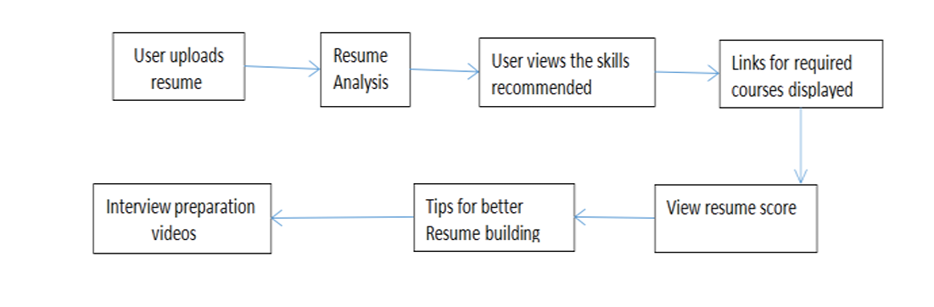
Proposed System(Cont..)
user interface where you can upload your resume and get the resume score and the recommendations required to boost your resume score.
It is mostly used for students who wants to work in IT fields
User Work Flow

Slide 8
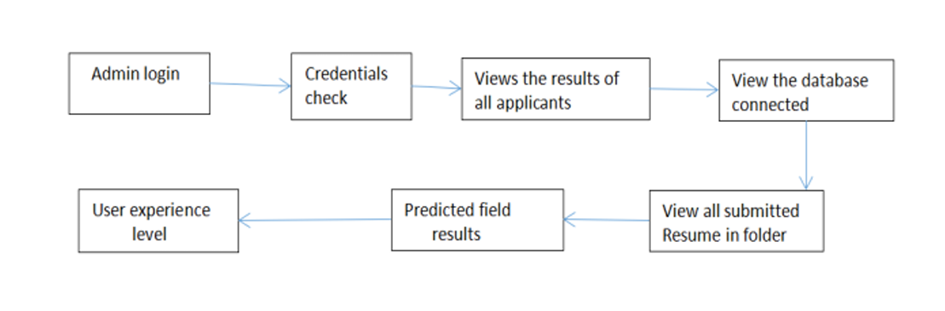
Proposed System(Cont..)
The administrative interface, you can access an Excel sheet containing the list of candidates who have used our website. Recruiters can evaluate the user's resume and score it based on the required skills for a specific position. This feature assists recruiters in selecting potential candidates for job openings
Admin Work Flow

Slide 9
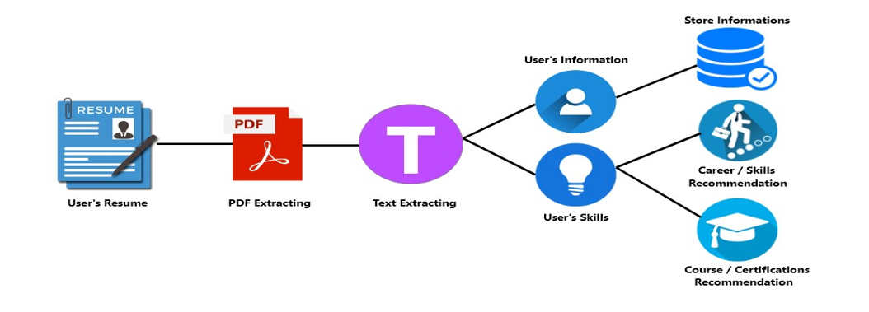
Design
Working of Smart Resume Analyzer

Slide 10
Working Of Smart Resume Analyzer
PDF Extracting
Text Extracting
User’s Data
Career/Skills Recommendations
Course/Certifications Recommendations
YouTube Video Recommendation

Slide 11
Implementation
Research and Planning of SRA
Selecting the Tools and Technologies
Designing of User-Interface
Implement SRA Backend using NLP
Merging Backend and User-Interface
Career and Skills Recommendations
Designing Admin Side
Implement You Tube Recommendations
Debugging and Testing

Slide 12
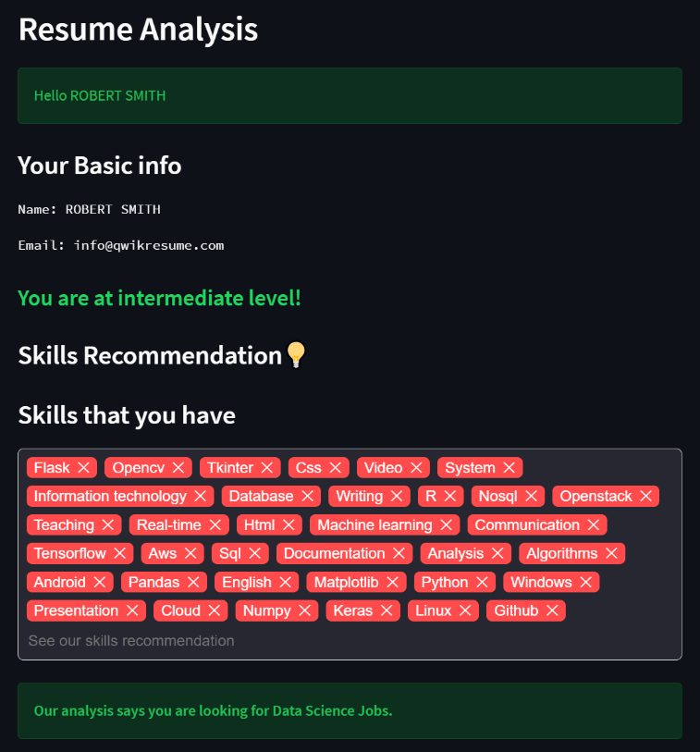
Results
The interpreter parses the pivotal data from the resume and auto-text a form for the user to interpret. After the confirmation, the resume is displayed to the users. Here, the user gets a complete overview of the resume in the GUI form. The interpreted data includes keywords such as education, certifications, work experiences, and social profiles.

Slide 13
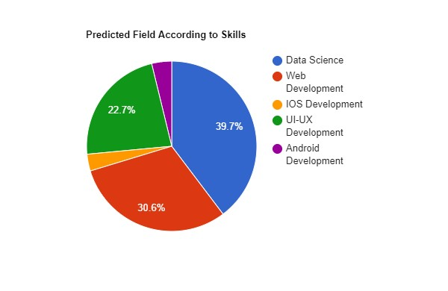
Results(Cont..)
We focused on the emerging and future-changing jobs that are available in the technical field. So the candidate must have the skills such as Data Science, Web Development, IOS Development, UI-UX Development, Android Development, etc. If these set of skills are mentioned in the resume then He/She will gain a better resume score.

Slide 14
Conclusion
With a growing number of graduates every year, Getting placed in a job is one of the concerns of a student. A resume is a self-prepared synopsis of a person. It usually consists of one’s experiences and skills.
A resume is usually the first thing a recruiter or an organization looks at to assess you. A strong resume leaves a strong first impression.
Analyzing one’s resume gives us key insight into what it lacks therefore enabling us to modify and make it better. Resumes are very underrated tools to help you land a job.

Slide 15
References
[1] A. Sinha and Md. Amir Khusru Akhtar, “Break Down Resumes into Sections to Extract Data and Perform Text Analysis using Python” , published in International Journal on Recent and Innovation Trends in Computing and Communication , 12 June 2023.
[2] Pravesh M.L and S. R, Mythili M,“RESUME ANALYZER”, Published in International Research Journal of Computer Science, 13 august 2022.
C.H. Ayishathahira and C. Sreejith, “Combination of Neural Networks and Conditional Random Fields for Efficient Resume Parsing” , Published in International CET Conference, 1 July 2018.

Slide 16


